Slide 1

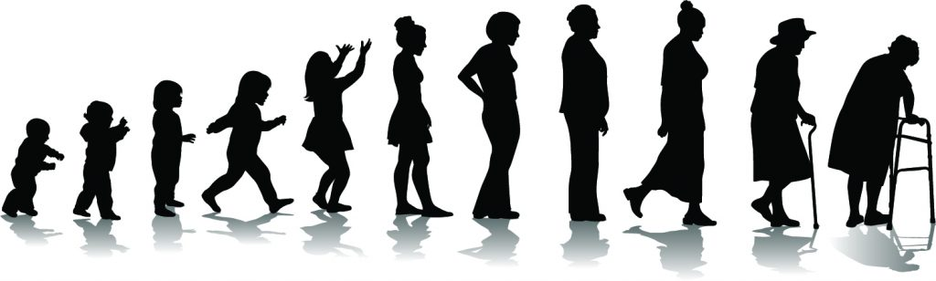
The Impact of Aging on People Living with HIV
Judith S. Currier, MD
University of California, Los Angeles
Healthy Aging for People Living with HIV: Achieving the 4th 90
AIDS 2018 Satellite Session, Wednesday, 25 July, 2018

Slide 2

Do not regret growing older.
It is a privilege denied to many.
Author Unknown
Notes:
First it is important to pause for a moment to acknowledge that advances in treatment have changed forever the prospects for people living with HIV.

Slide 3
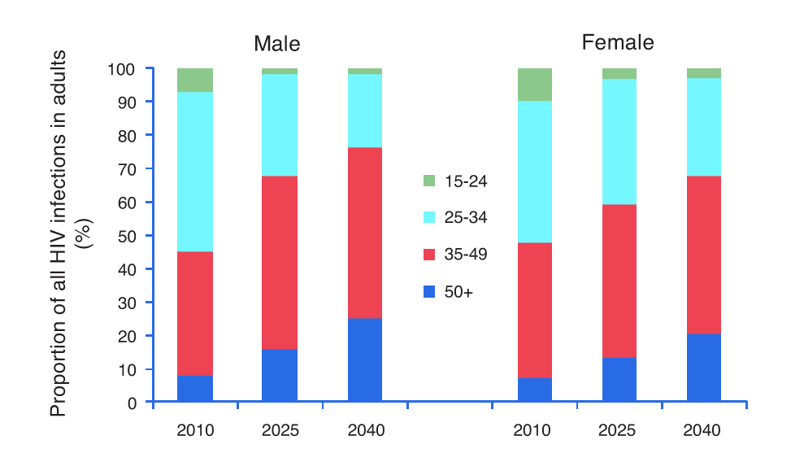
Aging with HIV in South Africa
HIV prevalence over the period 2000–2040 in the Hlabisa sub-district of KwaZulu-Natal, South Africa, predicted with the STDSIM model
Jan AC. AIDS 2011;25:1665-1673
Notes:
Fig. 1. HIV prevalence (in the 15–49 years and >50 years age groups), total number of infections, and age distribution of HIV-infected patients over the period 2000–2040 in the Hlabisa sub-district of KwaZulu-Natal, South Africa, predicted with the STDSIM model. Age distribution of HIV-infected men and women in 2010, 2025 and 2040.

Slide 4
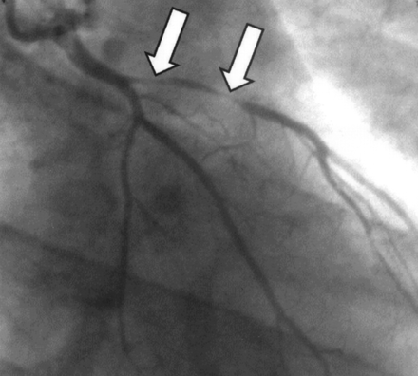
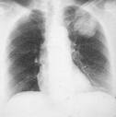

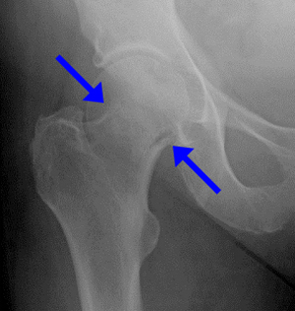
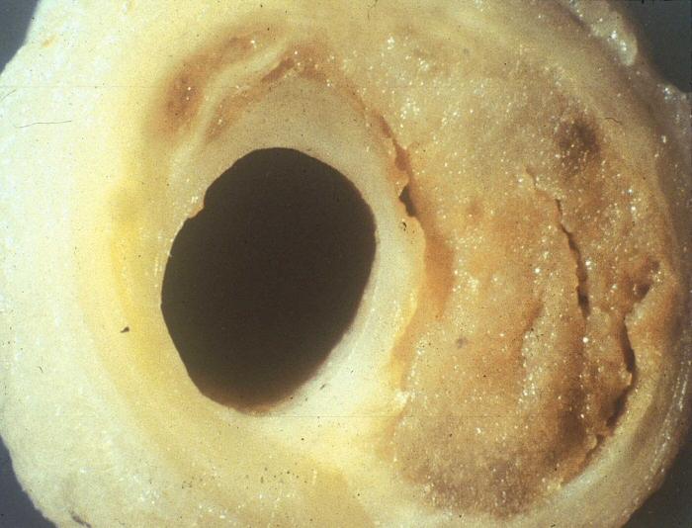

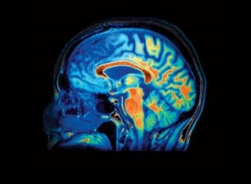
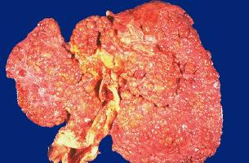
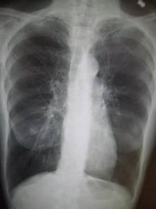
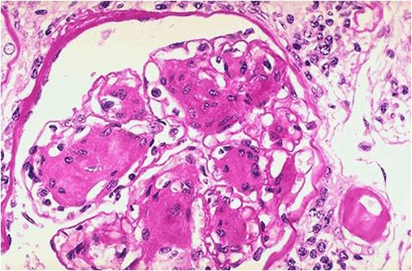
Non-AIDS cancers
Osteoporosis
CVD
Depression
Diabetes mellitus
Frailty
Cognitive disorders
Chronic renal disease
Slide P. Reiss
Chronic liver disease
COPD
Notes:
Many chronic conditions have been demonstrated to occur at higher rates in people with HIV on ART

Slide 5
Many age-associated diseases are more common in treated HIV disease than in age-matched uninfected persons
Cardiovascular disease
Cancer (non-AIDS)
Bone fractures/osteopenia
Left ventricular dysfunction
Liver failure
Kidney failure
Cognitive decline
Frailty
Multiple factors likely explain this increased risk, including co-morbid conditions, traditional risk factors and antiretroviral drug toxicity

Slide 6
“Traditional” Risk Factors Conspire with HIV to increase Morbidity and Mortality
Smoking is prevalent in most HIV cohort studies
  North American and European PLHIV risk losing more years of life due to smoking related illnesses than due to HIV in NA (AIDS 2015, 29:221–229)
Hypertension
  Prevalence in PLHIV vary by setting, unclear whether HIV directly increases the risk or response to anti-hypertensive therapy.
Diabetes
  Growing rates of diabetes in population globally in the background of HIV
Obesity
  Growing rates in the general population globally in the background of HIV

Slide 7
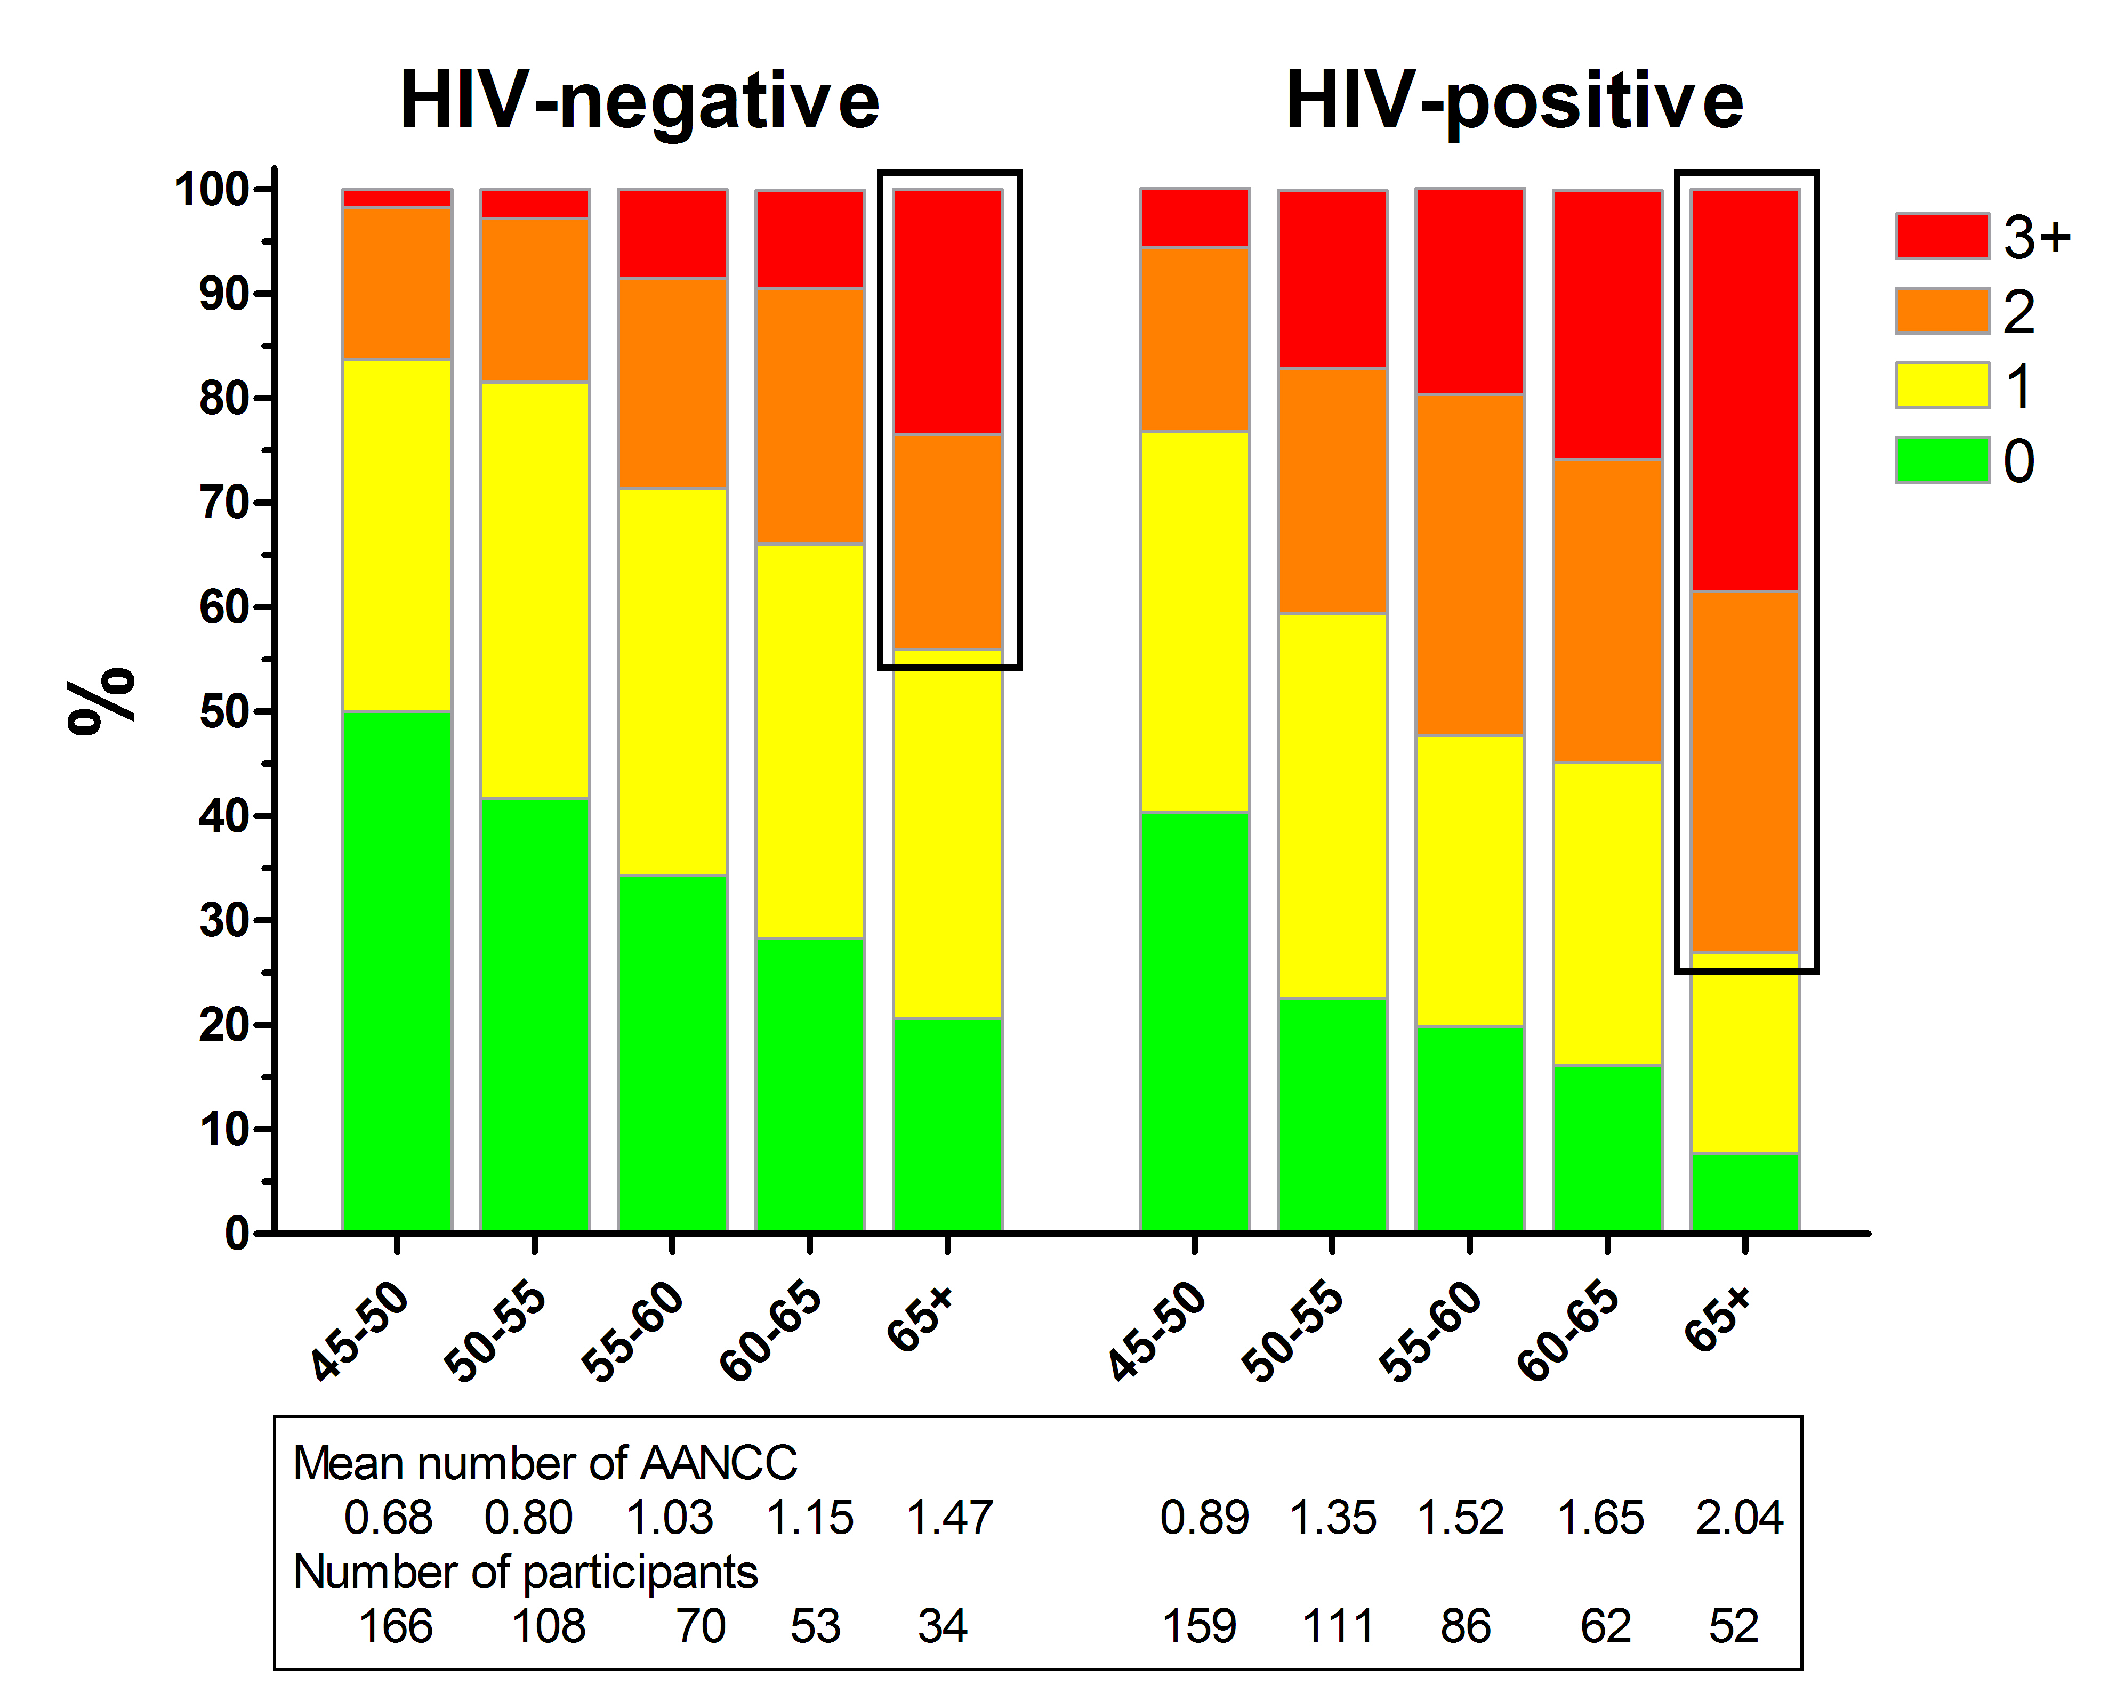
Comorbidity in relation to age
AANCC: age-associated non-communicable comorbidities
Schouten J AIDS 2012
Notes:
All Presentations
26 April, 2001
Satellite Symposium (FINAL)
7
Prevalence (and incidence) of age-associated non-communicable comorbidities (AANCC) and their risk factors in persons ≥45 yrs
Participants:
HIV-1-infected: from the HIV outpatient clinic at the Academic Medical Center (Amsterdam)
HIV-1-uninfected: from the Amsterdam Municipal Health Service sexual health clinic, and the ongoing Amsterdam Cohort Studies on HIV/aids
aids Associated Non Communicable Conditions included – Hypertension, Angina, MI, peripheral arterial insuffi, CVA, DM, COPS chronic liver disease, reduced renal function, Cancer and Atraumatic fractures and osteoporsis

Slide 8
Subset with well-controlled HIV
No prior co-morbidities
Viral load < 500
Still had reduced survival
compared to matched population controls
Legarth, A et al. JAIDS 2016

Slide 9
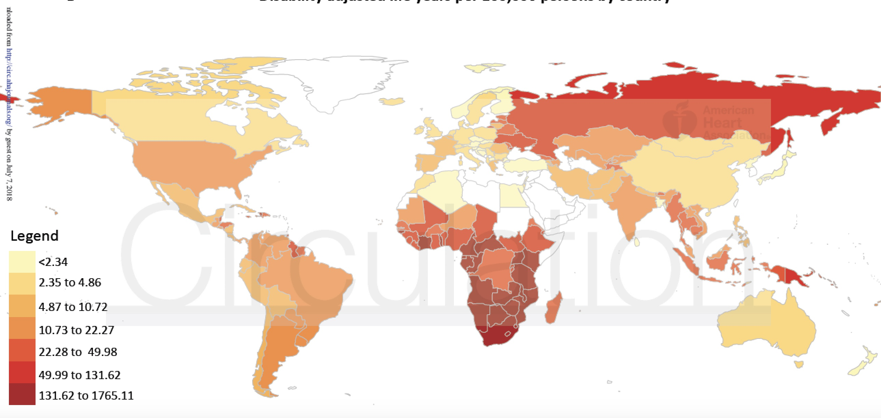
Population Attributable fraction of Cardiovascular Disease (CVD) due to HIV
The Global Population Attributable Fraction of CVD due to HIV
0.36% → 0.92% over past 26 years
Adapted by Shah, et al Circulation, July 2, 2018
Notes:
First, the crude rate for incident cardiovascular disease was 60
per 10,000 person years and is comparable to other high-risk cardiovascular groups, such as
diabetes mellitus.42 Second, the risk of incident cardiovascular disease was 2-fold higher in
people living with HIV. Third, the number of disability-adjusted life years due to HIV associated
cardiovascular disease has increased 3-fold over the last two decades but has now plateaued.
Finally, there were major regional variations in both the attributable fraction and the rates of
cardiovascular disease due to HIV, with much of the burden seen in sub-Saharan Africa followed
by Asia and the Pacific.
Over the last 26 years, the global population attributable
fraction from cardiovascular disease due to HIV increased from 0.36% (95%CI 0.21-0.56%) to
0.92% (95%CI 0.55-1.41%) and DALYs increased from 0.74 (95%CI 0.44-1.16) to 2.57 (95%CI
1.53-3.92) million

Slide 10
What Contributes to the Higher Risk of Age Related Diseases in HIV?
HOST
Genetics
Lifestyle
VIRUS/
Immune System
ART

Slide 11
Why do we see more Non-Infectious Complications in Treated HIV Disease?
HIV Infection
Loss of immuno-reguatory cells
Thymic dysfunction and loss of regenerative potential
Co-Infections
HIV replication
Loss of gut mucosal integrity and microbial translocation
ART
Defects in T cell regenerative potential
Loss of immuno-regulatory function
CMV and other copathogen levels
Microbial translocation
Inflammatory Lipids
Innate Immune Activation
Increased cell turnover and lymphoid fibrosis
Increased TF expression and clotting
Cytokine secretion (eg, IL-6, TNFL)
Immune exhaustion
CAD/stroke, thrombosis
“Inflam-Aging
(atherosclerosis, osteoporosis)
Malignancy
Deeks SG. 2001. Annu Rev Med, 62:141-55
Appay V, et al. J Pathol. 2008;214:231-241
Lederman ML, et al. Adv Immunol. 2013;119:51-83

Slide 12
Immune Activation and Non-AIDS Complications
Higher levels of Innate immune activation predict
  All cause mortality and individually
    CVD and thromboembolic disease (Duprez PLoS One 2012)
    Non-AIDS Cancers and Lymphoma (Breen, Cancer Epidemiol Biomarkers Prev 2011)
    Osteoporosis (Brown JID 2015)
    Type 2 Diabetes (Brown, Diabetes Care 2010)
    Fraility (Erlandson JID 2013)
    COPD (Attia Chest 2014)
    Bacterial pneumonia (Bjerk PLoS One 2013)
    Neurocognitive dysfunction (Burdo AIDS 2103)
Adaptive Immune activation
  T cell activation predicts morbidity/mortality (Balagopal A, et al JAIDS 2015)
  Stronger association in studies from resource limited settings (Hunt PW et al AIDS 2011)

Slide 13
Adipose Tissue
Major endocrine organ closely associated with the immune system
  Fat surrounds lymph nodes
  Adipocytes are prominent in bone marrow and fat depots
  CD4 ⁺ T cells in fat have activated memory phenotype
In obesity fat becomes pro-inflammatory with influx of CD8+ T cells that secrete IL-6 and TNF-alpha, these factors may stimulate HIV replication and or contribute to CVD, insulin resistance, diabetes and dyslipidemia
Two groups have reported on possible role of adipose tissue as a reservoir of HIV (Couturier AIDS 2015,29:667-674; Damouche, A. et al Plos Pathog. 11, e1005153)

Slide 15
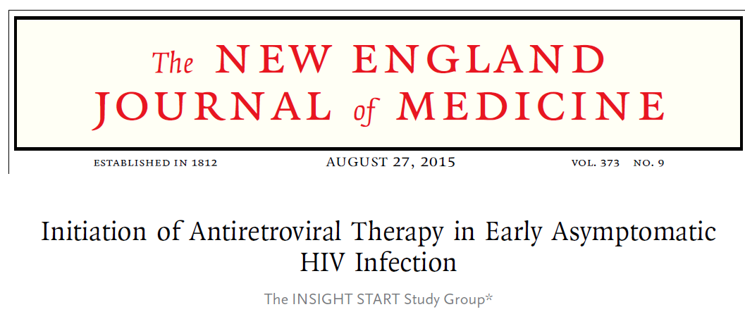
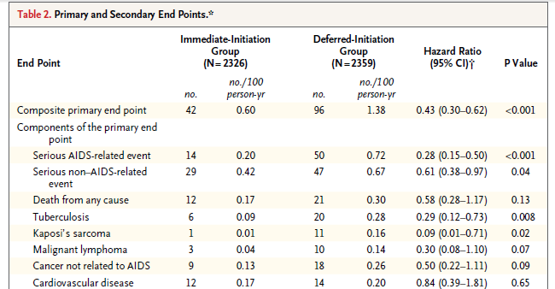
No apparent difference
in vascular function, neurocognitive performance, or COPD with early ART
Young low risk population overall: Median age of 36, 10 year CHD risk was 1.9
Low number of CV events N=12 in immediate and N=14 in deferred
Deaths due to CVD: 3 in immediate vs. 1 in deferred
Short FU 3 years

Slide 16
Interventions to Reduce Inflammation in ART Treated HIV Disease
Target | Interventions Studied or Ongoing
HIV Replication | ART at time of HIV diagnosis
Microbial Translocation | Prebiotics and Probiotics Fecal Transplantation
T cell function | IL-7, anti-PD 1 antibodies –studies in progress, safety issues
Inflammation | Statins COX-2 inhibitors, chloroquine, LD methotrexate (no benefit) IL-1β inhibition Toll-like receptor antagonists, JAK1/JAK2 inhibition
Treatment of Co-infections | CMV vaccine, CMV directed antivirals
Fibrosis of Lymphoid tissue | ACE Inhibitors, ARB’s
Abnormal Coagulation | Aspirin, apixaban, Dapigatran
Obesity, metabolic syndrome | Exercise, diet, metformin, Vitamin D
Cellular aging | Sirolimus, sirtuin activators

Slide 17
Key Points
Non-Infectious complications of HIV remain an important source of morbidity and mortality with the aging population with treated HIV
  These problems will persist despite the widespread use of early ART
    Very large population of people treated with low CD4 nadir and many who remain untreated globally
Interventions to reduce long term complications are still needed
  Opportunities to target interventions to those at highest risk and to tailor to individual risk profiles
Assessment and modification of traditional risk factors for CVD, CNS, cancer, liver disease need to be integrated into HIV treatment programs globally

